Slide 1

Automated Collection and Manipulation of Email
A.C.M.E.:
Ryan Peters
Notes:
Get one of those loony tunes acme rocket or dynomyte images for title slide background.

Slide 2
Purpose
Let Humans be Human
Be fluid, be adaptive, be modular
We must provide complete access to source code. Thus, empowering individuals to address and solve their own unique concerns and needs.
Help people invest their time and energy into new ideas and stronger human connections by separating and opening the computational tools to analyze our inbox.
Notes:
Humans be Human:
An often-overlooked key to effective collaboration and successful industry networking is to maintain focus on the human element of an interaction.
No one can be an expert at everything.
necessity is the mother of innovation
Processing the objective purpose of communications at the pace of modern work life is a non-trivial task.
You must assess not only what people are asking of you, but if you can even provide what they seek.
you must make sure you don’t overlook any corollary requests and secondary details.
it can often result in people losing sight of the human purpose of the interaction.
Collaboration
Relief from problems outside of their skill domain
Simple guidance/insight
Etc.
Be fluid, adaptive, modular:
Think of the project as an open-source tool bag allowing a user to:
Acquire email from a remote host
Convert the email into semantically meaningful parts
Imap header
Message body
Message thread structure
All while safeguarding against potential problems surrounding encode/decode conflicts and potential future changes to standards.
Provide a base framework that handles the more mundane and tedious tasks surrounding the generation of statistical and structured solutions for the challenge of automated email classification.
Operate under generic interface constraints, so that no one segment of the automation pipeline depends explicitly upon the previous.
This ensures user ease in extracting only the modules of the project that they need.
Help people break away from having to invest hours of their day trying to leverage past accomplishments, freeing them to put their time and energy into new ideas, stronger connections, or simply that all too neglected “me” time.

Slide 3
Tools and technologies used in this project
Development tools:
Python 3.9 and libraries:
NLTK -- Natural Language Processing tools.
SQLite 3 -- SQL bindings wrapper for database implementation in Python.
Doit -- Multi-stage task automation package that orchestrates the automated execution of the project’s sub-modules.
Pandas -- Data exploration package used in diagnostic evaluation of word counts and NLP tools as project is developed.
Numpy -- Efficient data containers and optimized data manipulation algorithms.
Numba -- JIT compilation of arbitrary python code to significantly faster c++ representations.

Slide 4
Project Breakdown
Three primary parts
Collect Email from imap server and cache to disk using SQLite DB;
Load email envelopes from disk and construct custom python dataclass objects for each email;
Cache these dataclass objects to disk as a separate SQLite DB
Load message bodies from disk and apply lemmatization/stop-word filtration before producing statistical word count data;
Cache lemma and statistical data to disk in another new SQLite DB.
Notes:
Red block:
This preserves imap protocol RFC822 specified “envelope” structure for ease of access should downloader module be extracted and used in a separate project.
Green block:
Exposes header meta-data as a dictionary, and the message body as a string;

Slide 5
Project Breakdown
Three primary parts
Collect Email from imap server and cache to disk;
Notes:
Get rid of program start and program end
Get better term for “task decomposition”
maybe” Project breakdown”
Make the presentation of the modularity visually simple

Slide 6
Project Breakdown
Three primary parts
Load email envelopes from disk and construct custom python dataclass objects for each email;
Exposing header meta-data as a dictionary, and the message body as a string;
Cache these dataclass objects to disk as SQLite DB.
Notes:
Get rid of program start and program end
Get better term for “task decomposition”
maybe” Project breakdown”
Make the presentation of the modularity visually simple

Slide 7
Project Breakdown
Three primary parts
Load message bodies from disk
Notes:
Get rid of program start and program end
Get better term for “task decomposition”
maybe” Project breakdown”
Make the presentation of the modularity visually simple

Slide 8
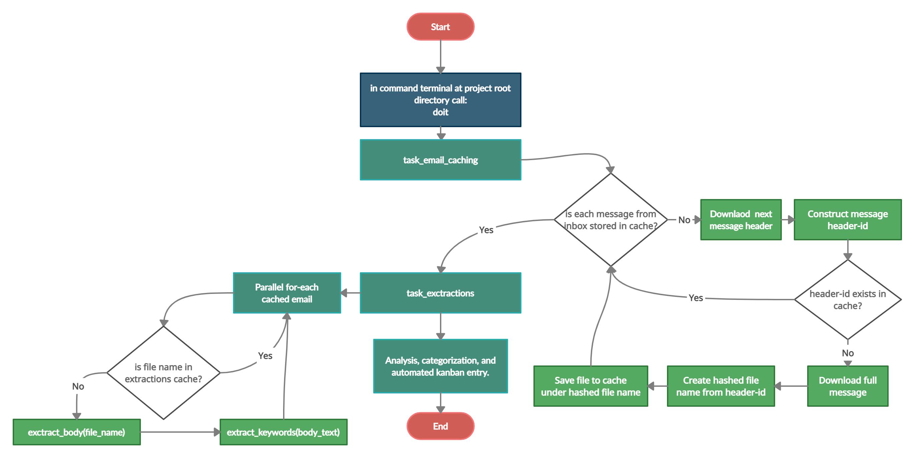
Program Flow
Obs vid of prog exec goes here

Slide 9
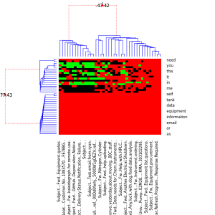
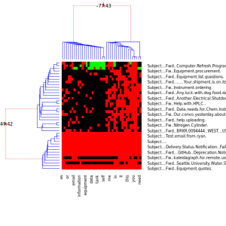
Email Classification
Bayesian Hierarchical clustering (BHC)
Notes:
Things to add to slide:
Say that it’s in R
We can now say we classified emails as well.

Slide 10
Conclusion
This should be a bulleted list of what was done, what the next steps look like,
(maybe interesting points along the way)
and finally, a thank you!
Thank Prof. Erdly, Dr. Marney, the UWB CSS dept, Kiera, and anyone else
that conceivably contributed.

Slide 11
Full link addresses
NLTK: Natural Language Toolkit for Python
https://www.nltk.org/

Slide 12
Existing Competitors
Melusine: An open source tool for performing automated classification of email messages.
https://github.com/MAIF/melusine/blob/master/melusine/models/attention_model.py
Notes:
We are working towards building a tool that lets a user get into the nuts and bolts of the automation, not an end product that just does it all for them.

Slide 13
Project Objectives
An often-overlooked key to effective collaboration and successful industry networking is to maintain focus on the human element of an interaction.
Help people break away from having to invest hours of their day trying to leverage past accomplishments, freeing them to put their time and energy into new ideas, stronger connections, or simply that all too neglected “me” time.
The need for this project arose from the realization that there is an absence of open-source tools for automated classification, storage, and response to communications that need to promote healthy human interaction.
Initially based on email messaging, this project aims to maintain strong modularity that promotes ongoing development into additional communication mediums, new application domains, and to permit future scalability.
This project provides:
Tools to automate away the tasks that distract from the human elements of a conversation.
Classifying incoming emails into actionable and informational.
Identify message patterns that result in unpersonal specifications gathering
Possible plans for automated response generation in the future.
Automated pipeline for adding objectives extracted from emails to appropriate categories in task/Kanban boards.
Notes:
In any line of work, it is generally obvious that one must organize available resources, keep track of various communications, and assign priority levels to their objectives; as doing these things effectively will often bring direct, measurably improved, results. It can even become a point of obsession for some, but at what cost?
When we become overly focused on tasks we can easily measure, we do so at the expense of those elements which serve as force multipliers for those tasks.

Slide 14
Project Outline
Objective
Tools and technologies used in this project
Terse program flow diagram
How to make program do objective
Task automation
Discretize stages of program flow – give a name to the program’s unique stages of execution
Parallelable execution – identify which stages may execute concurrently
Sequential dependencies – identify stages that depend upon the output of another
Data preprocessing
Data collection from imap server – initially collect header data only
Parsing and message id generation from imap header information – ensures no duplication of data
Caching and rudimentary security measures – download, encrypt, and save new messages; to keep an honest person honest.
Message body isolation and parsing. – content type identification, encoding corrections, attempt to identify signatures (messy)
Apply NLTK tools – strip “stop-words”, lemmatize, “wordbag”/”tf-idf”, cache
Visualize, analyze, and sensualize… yeah baby
Full link addresses – All embedded links found throughout this presentation will also appear in this final slide in it’s fully expanded form.
Identify existing competitor technologies

